Slide 1




business intelligence
DATA WAREHOUSE ARCHITECTURE
JURUSAN TEKNOLOGI INFORMASI
POLITEKNIK NEGERI MALANG
FAST: FOCUS, ADAPTIVE, SINCERE, TRUSTWORTHY

Slide 2

OUTLINE
Review of Data Warehouse Basic Concepts Architectural Models Warehouse Data Structure Data Management in Data Warehouse
JURUSAN TEKNOLOGI INFORMASI
POLITEKNIK NEGERI MALANG
FAST: FOCUS, ADAPTIVE, SINCERE, TRUSTWORTHY

Slide 3
Review of Data Warehouse Basic Concepts
Bagian 1
JURUSAN TEKNOLOGI INFORMASI
POLITEKNIK NEGERI MALANG
FAST: FOCUS, ADAPTIVE, SINCERE, TRUSTWORTHY

Slide 4


DATA WAREHOUSE
01
03
General Understanding A data warehouse is a system that archives and analyzes historical data for decision-making.
Roles in Business As the main reference in proper and efficient business decision-making.
05
Differences with Databases Databases are used for the day-to-day operations of data warehouses are used for in-depth business analysis.
02
04
Main Functions As the main reference in proper and efficient business decision-making.
The Importance of Data Warehouses as the core of a business information infrastructure, which enables organizations to efficiently collect, integrate, and analyze data from multiple sources.
FAST: FOCUS, ADAPTIVE, SINCERE, TRUSTWORTHY
JURUSAN TEKNOLOGI INFORMASI
POLITEKNIK NEGERI MALANG

Slide 5
Architecture Models
Bagian 2
JURUSAN TEKNOLOGI INFORMASI
POLITEKNIK NEGERI MALANG
FAST: FOCUS, ADAPTIVE, SINCERE, TRUSTWORTHY

Slide 6
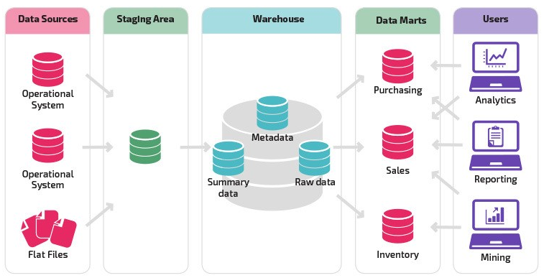
Layers of a Data Warehouse Architecture
While there can be various layers in a data warehouse architecture, there are a few standard ones that are responsible for the efficient functioning of the data warehouse software. These include:
Source Layer
The source layer is where the different types of data from various sources such as CRM, ERP, or even spreadsheets are collected and subsequently sent to other layers.
Staging Layer
From the source layer, the data moves to the staging layer where it is temporarily stored, organized, and goes through several quality checks. This is popularly called the Extract, Transform, and Load (ETL) process and is done to ensure the data processing is efficient.
Warehouse Layer
The warehouse layer or the core layer is where the processed data from the staging layer is stored and optimized for analysis. This layer leverages a standardized data structure to move the data into different tables.
Presentation Layer
The presentation layer (also known as the consumption layer) is where analysts and other users can access the data. It allows users to leverage queries and tools to extract insights, generate reports, and make informed decisions. This layer consists of data marts and data interfaces that present data related to a specific subject area to a particular group of users in the required format.

Slide 7




Model Arsitektur
Single-tier Architecture
01
02
Two-tier Architecture
Integrated Business Intelligence Architecture
Three-tier Architecture
03
04
FAST: FOCUS, ADAPTIVE, SINCERE, TRUSTWORTHY
JURUSAN TEKNOLOGI INFORMASI
POLITEKNIK NEGERI MALANG

Slide 8
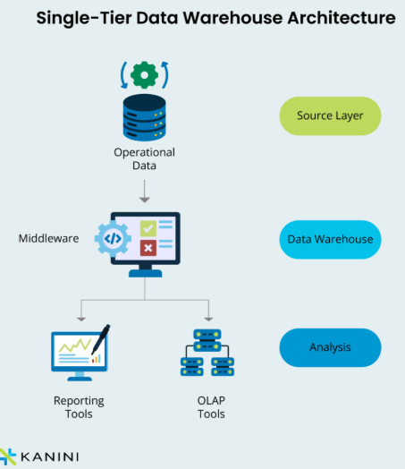
Single-Tier Architecture
This model involves data storage, ETL processes, and analytical tools in a single system.Suitable for small organizations with simple needs and not too large volumes of data. The main advantages are simplicity and low cost.The disadvantages are the lack of scalability and limitations in managing very large or complex data
Additionally, in a single-tier architecture, analytical processing (e.g. Generating a report) and transactional processing (e.g. recording purchases made by a customer) happen together in the same system, which causes performance issues.
FAST: FOCUS, ADAPTIVE, SINCERE, TRUSTWORTHY
JURUSAN TEKNOLOGI INFORMASI
POLITEKNIK NEGERI MALANG

Slide 9
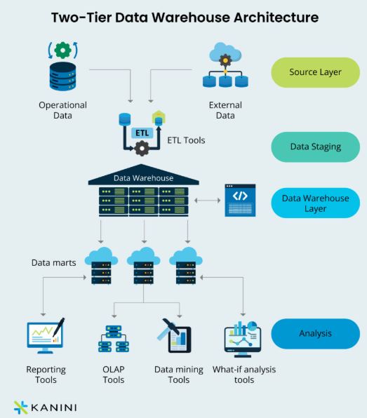
Two-Tier Architecture
This model separates between data storage (data warehouse) and analysis tools (e.g., OLAP servers). The data is retrieved and loaded from external sources into the data warehouse through the ETL process, and then analyzed using separate analysis tools. Suitable for organizations with larger data volumes and complex analysis needs. Its advantages include separation between storage and analytics, as well as the ability to improve performance and scalability.
While this data warehouse architecture provides more value than a single-tier architecture, it comes with scalability issues, making it unsuitable for large businesses.
FAST: FOCUS, ADAPTIVE, SINCERE, TRUSTWORTHY
JURUSAN TEKNOLOGI INFORMASI
POLITEKNIK NEGERI MALANG

Slide 10
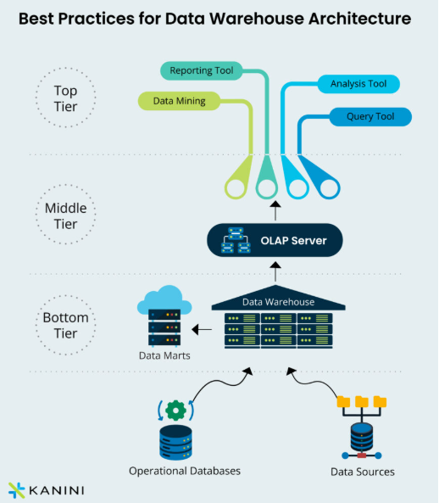
Three-Tier Architecture
This model divides the architecture into three layers: the data source layer, the data storage layer (data warehouse), and the presentation layer (analysis and reporting tools). The ETL process is done between the data source layer and the data storage layer, while analysis and reporting are done at the presentation layer. Suitable for organizations with complex needs and large scale, which require flexibility and scalability. The advantages include separation of duties, scalability, and flexibility in data management and analysis
FAST: FOCUS, ADAPTIVE, SINCERE, TRUSTWORTHY
JURUSAN TEKNOLOGI INFORMASI
POLITEKNIK NEGERI MALANG

Slide 11
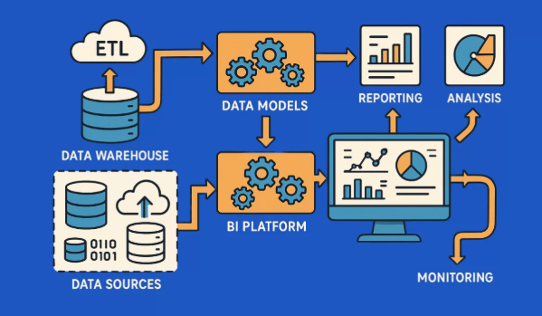
Integrated Business Intelligence Architecture
This model integrates data warehouses with operational systems and other business applications. Data is retrieved in real-time or near real-time from operational sources into a data warehouse, and then used for analysis and reporting. Suitable for organizations that prioritize quick access and up-to-date information. The advantage is the ability to generate business insights faster and be responsive to market changes.
FAST: FOCUS, ADAPTIVE, SINCERE, TRUSTWORTHY
JURUSAN TEKNOLOGI INFORMASI
POLITEKNIK NEGERI MALANG

Slide 12
Struktur Data Warehouse
Bagian 3
JURUSAN TEKNOLOGI INFORMASI
POLITEKNIK NEGERI MALANG
FAST: FOCUS, ADAPTIVE, SINCERE, TRUSTWORTHY

Slide 13
OLTP vs OLAP
 | OLTP | OLAP
Main Objectives | daily business transactions, | Analyze business data in depth
Types of Operations | transaction operations such as additions, deletions, and updates. | Perform complex data analysis operations such as complex queries, aggregation, and multidimensional modeling
Volume Data | Manage large volumes of data in operational databases. | large volumes of data from the data warehouse.
Data Structure | The data structure used is a relational structure | The data structure used can be in the form of dimensional models
Users and Use Cases | Commonly used by operational users | Typically used by business analysts or managers
Response Speed | It has a very fast response time to process transactions in real-time. | Response times may be slower than because they involve large and complex data access.
FAST: FOCUS, ADAPTIVE, SINCERE, TRUSTWORTHY
JURUSAN TEKNOLOGI INFORMASI
POLITEKNIK NEGERI MALANG

Slide 14
Tabel Dimensi dan Tabel fakta
A dimension table is a table that stores information about the dimensions or characteristics of the data measured in a data warehouse. Dimensions are different angles of data, such as time, location, product, or customer. Examples of attributes in a time dimension table can include date, month, year, day, hour, etc. Dimension tables typically have a relatively flat structure and consist of a primary key and several descriptive attributes.
A fact table is a table that stores the data that is measured or observed in a data warehouse, as well as numerical information related to a specific dimension. Facts in a fact table are often the size or metrics of a business, such as sales, revenue, or the number of items sold. Each row in the fact table represents an event or business transaction that is observed and recorded. A fact table usually consists of two types of columns: dimension keys that serve as foreign keys to the dimension table and columns that store the factual values.
FAST: FOCUS, ADAPTIVE, SINCERE, TRUSTWORTHY
JURUSAN TEKNOLOGI INFORMASI
POLITEKNIK NEGERI MALANG

Slide 15
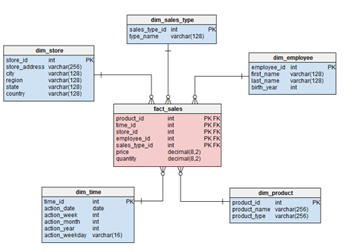
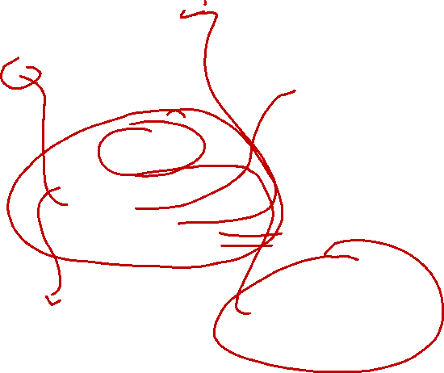
STAR SCHEMA
Simple and Easy to Understand: Star schema has a simple and easy-to-understand structure, making it one of the most popular models in data warehouse design. The clear and intuitive structure facilitates fast data capture and analysis.
FAST: FOCUS, ADAPTIVE, SINCERE, TRUSTWORTHY
JURUSAN TEKNOLOGI INFORMASI
POLITEKNIK NEGERI MALANG

Slide 16
STAR SCHEMA
Fact Table: The fact table serves as the central point in the star schema. Fact tables store measured or observed data, such as business metrics or sales figures. Each row in the fact table represents an observed business event or transaction. Fact tables usually have dimension keys (foreign keys) that connect them to the dimension table.
FAST: FOCUS, ADAPTIVE, SINCERE, TRUSTWORTHY
JURUSAN TEKNOLOGI INFORMASI
POLITEKNIK NEGERI MALANG

Slide 17
STAR SCHEMA
2. Table Dimensions: Dimension tables store information about the dimensions or characteristics of the data measured in the data warehouse. Dimensions can be time, product, customer, or any other dimension relevant to the analysis. Each dimension table typically has one row for each unique value in that dimension. A dimension table has a one-to-many relationship with a fact table, where a single row in a dimension table can relate to multiple rows in a fact table.
FAST: FOCUS, ADAPTIVE, SINCERE, TRUSTWORTHY
JURUSAN TEKNOLOGI INFORMASI
POLITEKNIK NEGERI MALANG

Slide 18
STAR SCHEMA
3. Relationships Between Tables: The relationship between a fact table and a dimension table is star, where the fact table serves as the center and the dimension table serves as the "arm" of the star that contacts it. This relationship is usually done through dimension keys, where the dimension keys in the fact table are the foreign keys that connect them to the dimension table.
FAST: FOCUS, ADAPTIVE, SINCERE, TRUSTWORTHY
JURUSAN TEKNOLOGI INFORMASI
POLITEKNIK NEGERI MALANG

Slide 19
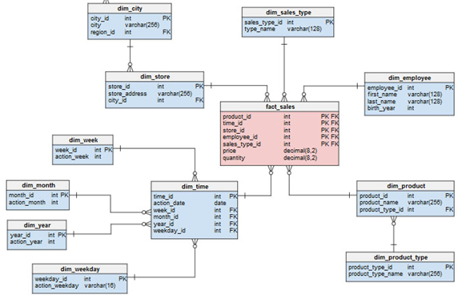
SNOWFLAKE SCHEMA
FAST: FOCUS, ADAPTIVE, SINCERE, TRUSTWORTHY
JURUSAN TEKNOLOGI INFORMASI
POLITEKNIK NEGERI MALANG

Slide 20
SNOWFLAKE SCHEMA
Fact Table:The fact table is the center of the snowflake schema, which stores the measured or observed data, as well as the associated dimension keys. Each row in the fact table represents an event or business transaction that is observed and recorded. The columns in the fact table include dimension keys that connect them to the dimension table, as well as fact attributes such as business metrics or size.
FAST: FOCUS, ADAPTIVE, SINCERE, TRUSTWORTHY
JURUSAN TEKNOLOGI INFORMASI
POLITEKNIK NEGERI MALANG

Slide 21
SNOWFLAKE SCHEMA
2. Table Dimensions: A dimension table is a table that stores information about the dimensions or characteristics of the data measured in a data warehouse. These dimensions can include information such as time, product, customer, and location. In a snowflake schema, a dimension table can be divided into smaller or normalized tables, forming "branches" or "branches" that lead to more detailed or specific dimensions.
FAST: FOCUS, ADAPTIVE, SINCERE, TRUSTWORTHY
JURUSAN TEKNOLOGI INFORMASI
POLITEKNIK NEGERI MALANG

Slide 22
SNOWFLAKE SCHEMA
3. Relationships Between Tables: The relationships between tables in a snowflake schema illustrate how the fact tables are connected to the dimension table and how the dimension tables might be connected to each other. The relationship between tables usually occurs through the foreign keys in the fact table that refer to the primary keys in the dimension table. In addition, in a snowflake schema, the dimension tables can be connected to each other through foreign keys that form the normalization structure.
FAST: FOCUS, ADAPTIVE, SINCERE, TRUSTWORTHY
JURUSAN TEKNOLOGI INFORMASI
POLITEKNIK NEGERI MALANG

Slide 23
Data Warehouse Management
Bagian 4
JURUSAN TEKNOLOGI INFORMASI
POLITEKNIK NEGERI MALANG
FAST: FOCUS, ADAPTIVE, SINCERE, TRUSTWORTHY

Slide 24
Data Warehouse Management
Table Facts
Data Maintenance Performance Query Data Updates
Table Dimensions
Dimension Management Techniques Time Dimension Hierarchical Dimensions
Data Quality
Data Cleansing Techniques Quality Control
Data Security
Data Security Risks Data Protection Strategy Regulation
FAST: FOCUS, ADAPTIVE, SINCERE, TRUSTWORTHY
JURUSAN TEKNOLOGI INFORMASI
POLITEKNIK NEGERI MALANG

Slide 25
Thanks

